Slide 1

STATIC-WEBPAGE
ABSAAR SHEIKH(24K-0976) UMAIR AHMED(24K-0677) JAZLAN BIN MOGHIS(24K-0765) BHUMIKA RANI(24K-0960)

Slide 2
Project Overview
Introduction:
:A webpage inspired by Amazon but for a weaponry store.
The goal was to create a smooth, user-friendly experience with a clean layout and intuitive navigation
Objectives
:Reproduce the layout, features, and visual appeal of Amazon.
Develop a responsive, user-friendly interface.
Include features such as:
Product pages for rifles, pistols, and accessories.
A cart system.
A dynamic menu with a complex header.
.

Slide 3
Structure and Flow of the Webpage
Homepage (Index Page):
Contains navigation to different product categories (Rifles, Pistols, Accessories).
Features a header with a menu bar for easy access to different sections.
Product Pages:
Clicking on categories like Rifles or Pistols opens dedicated pages with product listings.
Cart Page:
Shows items added to the cart with a button to increase/decrease the quantity.
Responsive Design:
The layout adapts to different screen sizes (desktop, tablet, mobile).

Slide 4
Key Design Elements and Interactivity
Design Elements:
Simple, clean layout mimicking Amazon's design.
Clear typography and product images for easy navigation.
Colors and spacing used to highlight key sections.
Interactivity Features:
Navigation Bar: Dynamic, with smooth scrolling between sections.
Add to Cart Functionality: Increases cart count with JavaScript when items are added.
Pop-ups: Created with JavaScript to display extra product information or cart details.

Slide 5
Challenges and Solutions
Challenges:
Cart Count Issue: Initially had difficulty with the JavaScript code for tracking the cart count.
Pop-up Design: Struggled to create a pop-up without opening a new page.
CSS Inline Styling: Inline styling created issues with consistent page design.
Solutions:
Used JavaScript to properly manage the cart count and ensure it updates with every addition.
Researched and implemented pop-ups using hidden divs and changing CSS properties with JavaScript.
Replaced inline styles with CSS Flexbox for better design management and responsiveness.

Slide 6
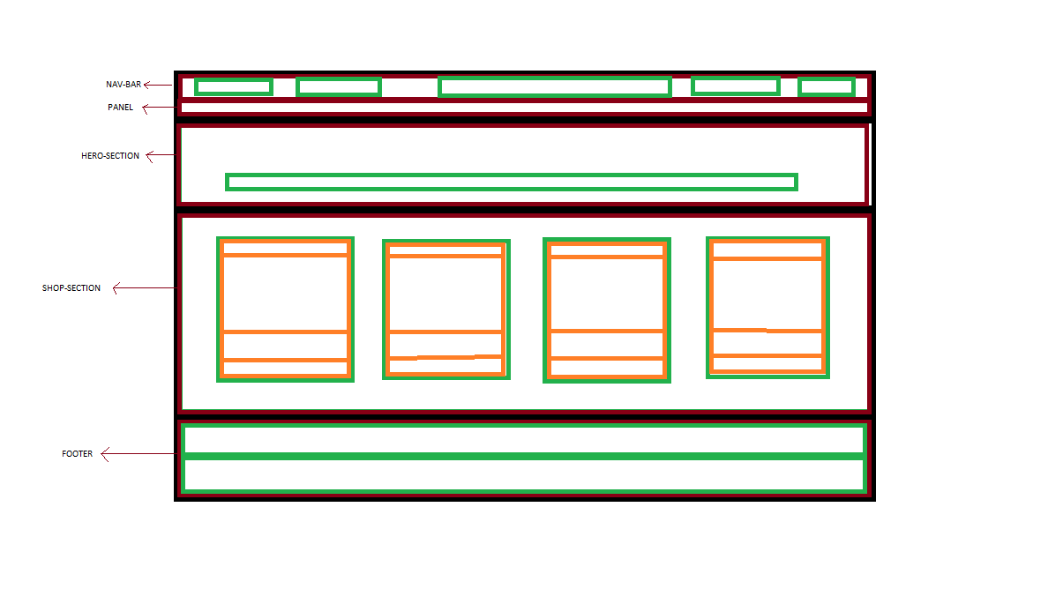
A FREE BODY DIAGRAM OF THE FLOW:

